Slide 1
If/else ternary switch etc.
There is nothing wrong with being unsure so ask questions!
This is your learning time!

Slide 2
Previously on Javascript 101…
We learnt:
Adding JS to HMTL
Variables
Data types
Concatenating
Basic/logical operators
Coding challenges

Slide 3
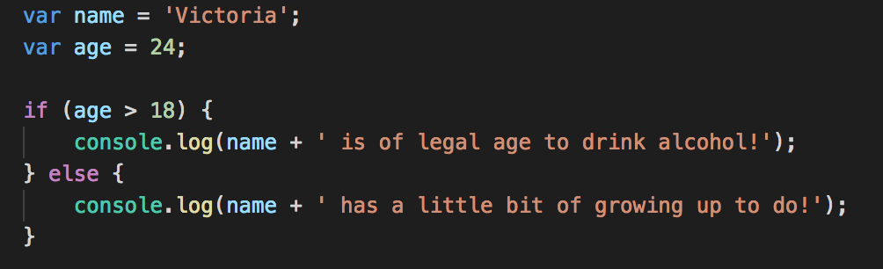
If/else
If/else is a conditional statement that allows us to run a block of code if certain conditions are met.
If (this is true) {
do this
} else {
do this instead
}

Slide 4
Cascading if/else statement
If/else statements but looooong:
If (this is true) {
do this
} else if (this) {
do this instead
} else if (this) {
do this instead
} else if (this) {
do this instead
} else {
finally do this
}

Slide 5
Boolean logic
We can manipulate the if/else stamens by using different variations of operators (which we covered with Francisco in previous lesson).
Just a reminder an example of operators is the following: ! < > && || == ===
Just like in previous lesson, its good to look at Operator Precedence:
https://developer.mozilla.org/en-US/docs/Web/JavaScript/Reference/Operators/Operator_Precedence
*As mentioned in previous lesson, there is a big difference between == and ===.

Slide 6
And | or | not
AND | TRUE | FALSE
TRUE | TRUE | FALSE
FALSE | FALSE | FALSE
AND ( && ) true if ALL are true
OR ( || ) true if ONE is true
NOT ( ! ) inverts true/false value
OR | TRUE | FALSE
TRUE | TRUE | TRUE
FALSE | TRUE | FALSE

Slide 7
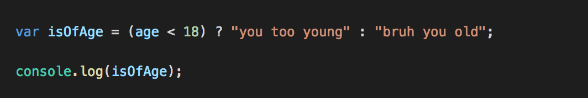
Ternary operator
If/else statements but shorter.
variable = (true statement) ? do this : otherwise do this;

Slide 8
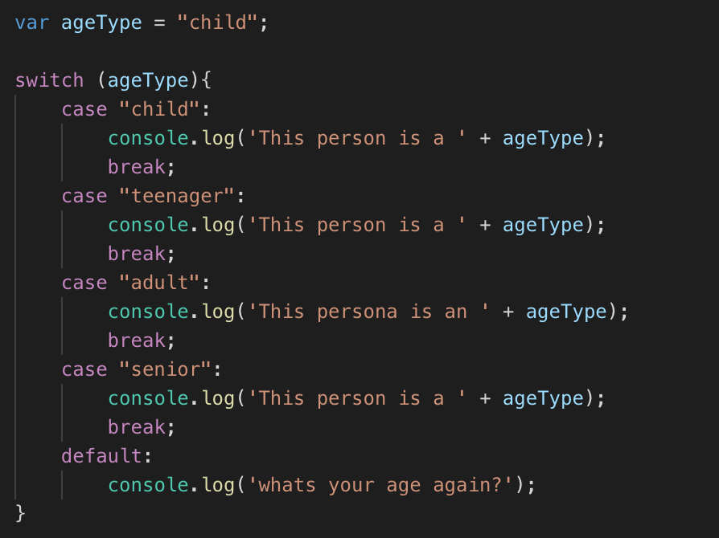
Switch statement
A long if/else stamen but more efficient.
Variable
switch (tell me what you looking for){
case “option a”:
do this;
break; //otherwise it will list all the options.
case “option b”:
do this;
break;
case “option c”:
do this;
break;
default:
since it’s none of the above do this instead;
}

Slide 9
Switch statement with numbers
You can use switch statement to compare numbers. All you have to do is put the condition in brackets like so:
case (20 < 30):
console.log(‘blah’);

Slide 10
Truthy/Falsy Values

Slide 11
Falsy Values
Falsy value is a value that is considered false when evaluated in if/else condition:
False
Undefined
Null
0
‘ ’(empty string)
NaN
These values are not necessarily false but would be accepted as false.

Slide 12
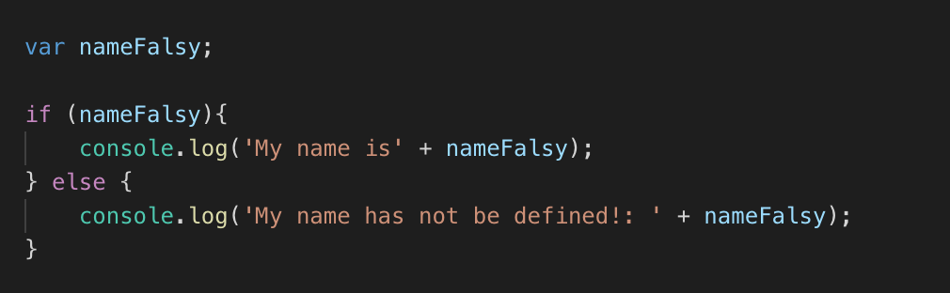
Truthy values
Simply NOT falsy values…
Here’s an example:

Slide 13
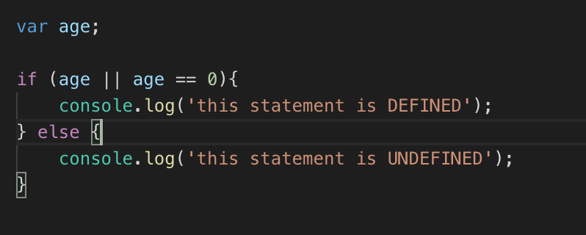
What will the console show us?

Slide 14
Coding challenge!

Slide 15
You are given a variable marks. Your task is to print: - AA if marks is greater than 90. - AB if marks is greater than and less than 80 or equal to 90. - BB if marks is greater than and less than 70 or equal to 80. - BC if marks is greater than and less than 60 or equal to 70. - CC if marks is greater than and less than 50 or equal to 60. - CD if marks is greater than and less than 40 or equal to 50. - DD if marks is greater than and less than 30 or equal to 40 . - FF if marks is less than or equal to 30.

Slide 16
John and Mike both play basketball in different teams. In the latest 3 games, John's team scored 89, 120 and 103 points, while Mike's team scored 116, 94 and 123 points.
1. Calculate the average score for each team
2. Decide which teams wins in average (highest average score), and print the winner to the console. Also include the average score in the output.
3. Then change the scores to show different winners. Don't forget to take into account there might be a draw (the same average score)

